Slide 1
Title: University of Toronto – Data analytics & Visualization Bootcamp
Project 4 – Machine Learning
Job Change of Data Scientists
Predict the probability of a candidate to look for a new job or will work for the company, as well as interpreting affected factors on employee decision.
Participants:
Ronald Lam
Richard Gu
Daniel Yoon
Arsam Ijaz

Slide 2
Sources:
Main Dataset - https://www.kaggle.com/datasets/arashnic/hr-analytics-job-change-of-data-scientists?taskId=3015
Research - https://www.zippia.com/advice/employee-turnover-statistics/#Employee_Turnover_Statistics_by_Industry
- https://www.hcamag.com/ca/specialization/employee-engagement/your-people-are-quitting-over-a-lack-of-training-heres-what-hr-can-do/416028
- https://www.entrepreneur.com/growing-a-business/your-top-employees-are-learning-new-skills-on-their-own/296636
- https://www.visier.com/blog/the-surprising-reason-people-quit-their-jobs-that-no-one-talks-about/
https://rapidminer.com/downloads/talent-crisis/
Possible way of presenting

Slide 3
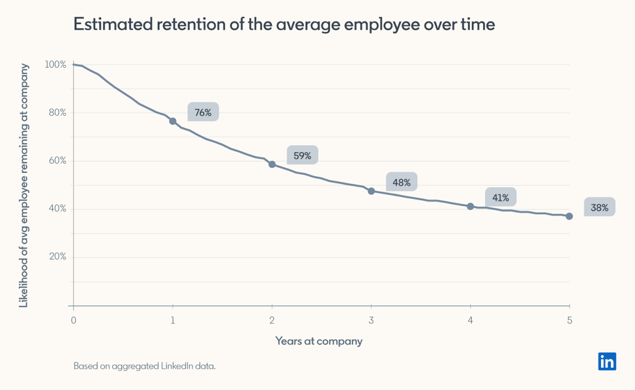
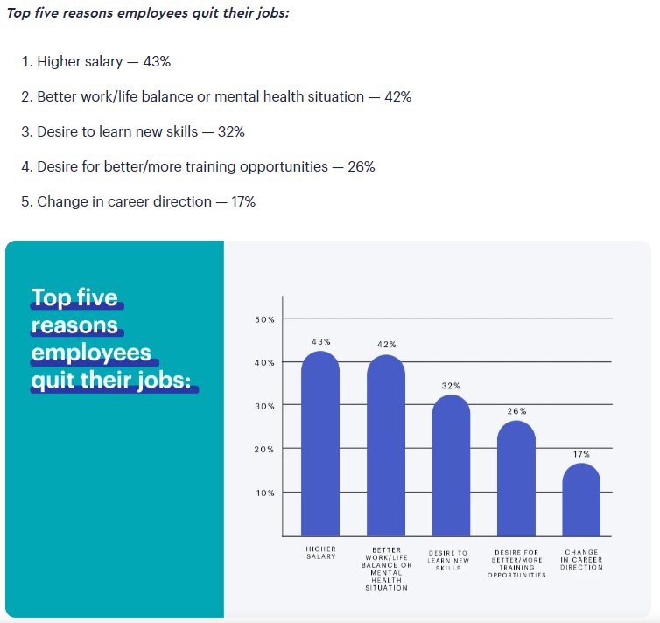
https://business.linkedin.com/talent-solutions/recruiting-tips/thinkinsights/retention-at-companies#:~:text=We%20looked%20at%2032%20million,years%2C%20a%2048%25%20chance.
Cost of turnover: … six to nine months of their salary…
In 2022, the overall cost of voluntary employee turnover amounted to over $1 trillion
https://www.zippia.com/advice/employee-turnover-statistics/
today’s data-science professionals will remain with their current employers a mere 1.7 years on average
https://www.visier.com/blog/the-surprising-reason-people-quit-their-jobs-that-no-one-talks-about/
https://www.globenewswire.com/news-release/2021/10/15/2314725/0/en/Study-Reveals-High-Turnover-Rates-Among-Data-Science-Professionals.html

Slide 4
Companies are now highly invested in being able to retain their workforce, and a tool they want to use is being able to provide additional skills in the form of courses to their employees that would be willing to learn.
The outcome of this would be a) a more engaged workforce and b) a workforce that is more skilled and able to benefit the company by using those skills, resulting in higher employee retention.
However, not all companies can provide additional skill training to ALL their employees. Therefore need to strategize by identifying what their highest rate of return. Highest rate of return at the moment is measured by the companies by ensuring that the employee, after receiving the additional skills training, is not going to leave.
We’ve generated a machine learning model that uses the following data;
The goal is to create an accurate model that would allow the companies to identify what characteristics they need to look for to train their workforce and ensure that those individuals will be staying with the company.

Slide 5
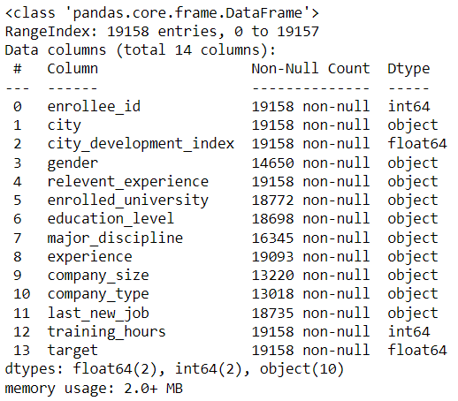
HR Analytics: Job Change of Data Scientists
Creating a machine learning model to verify probability of employees in Data Sciences leaving a role AFTER learning a new skill.
Dataset Provided

Slide 6
Preprocessing
Original Data – Accuracy Score: 0.74

Slide 7
Slide 2:
Dataset description
Features
Purpose
Use of languages and programs
Data storage form (SQL)

Slide 8
Slide 3:
Modeling
Types of models used
Iterative processes
Preprocessing

Slide 9
Slide 4:
Results
Discussion on affected factors
Matrices of recall and accuracy description
Definition of results
Value of results

Slide 10
Slide 5:
Conclusion
Chart comparison between Anything found on LinkedIn and what our data shows us (Potenial)

